Slide 1
Multiple Regression, Part 2
SSI II
February 21, 2019

Slide 2
Previously
Multiple Regression
Interpretation of Coefficients
Goodness of Fit

Slide 3
Essential Questions
How do we interpret the results of a multivariate regression?

Slide 4
From last time…
How does multivariate regression work?
Why is it important to have the right model?
How are significance and substantive effect related?

Slide 5
R-Squared
Still:
Or, written another way:
But NOT:
R² (multivariate) = (r_{yx1})²+ (r_{yx2})²

Slide 6
R-squared
Why not?
Because some of the individual correlations with Y are actually joint effects (or joint sums of squares)
This is because of the correlation between X₁ and X₂
These joint effects would be double counted
R² (multivariate) = (r_{yx1})²+ (r_{yx2})²

Slide 7
R-squared
However, we can say:
And:

Slide 8
Multivariate R-squared
As you add variables:
Will never decrease
Will usually increase, at least some
This is true whether or not the variables are relevant

Slide 9
Multivariate R-squared
Logically, if you have:
2 cases, any 1 variable will perfectly predict the outcome for those two cases
3 cases, any 2 variables will perfectly predict
4 cases, any 3 variables will perfectly predict
Etc.
So it seems we want a statistic that will take into account the number of independent variables (k), relative to the number of cases

Slide 10
Adjusted R-squared
Also called “R-bar-squared”
k is the number of IVs, and N is the number of cases

Slide 11
Adjusted R-squared
In small samples, as k increases, the adjustment could be substantial
Adjusted R-squared can:
Decrease when adding new variables
Can be <0

Slide 12
Example
South Africa Data
St.Dev. Correlation Matrix
Political Knowledge 1.94 1.00
Civic Education 1.18 .216 1.00
Education 1.37 .562 .122 1.00
R-squared (multivariate):
Adjusted R-squared:

Slide 13
Hypothesis Testing
Where
Yuck. Yay for R.

Slide 14
Hypothesis Testing
Now, if there is too much multicollinearity, the standard errors will explode and, when r=1, become impossible to calculate
Otherwise, the logic for multivariate is similar to bivariate:
A better model (more variance explained, smaller residuals) will decrease the standard errors
A larger N will decrease the standard errors
More variation in X(s) will decrease the standard errors
Having fewer IVs in relation to N will decrease the standard errors

Slide 15
Dropping an Insignificant Variable
General rules:
It is statistically insignificant
It is not substantively significant (β is low)
Adjusted R-squared shows no improvement after including it (e.g. <.01)
It is not highly correlated with other variables with similar problems
A small N of cases is not the sole reason to drop it
It is not a crucial theoretical variable that everyone expects to be included

Slide 16
F-test
Do all of the explanatory variables, together, account for a significant amount of variance in Y?
Can we reject the hypothesis that the slopes of all variables are equal to 0 in the population?

Slide 17
F-test
H₀: β₁= β₂ = β_{i} =0
H₀: R² =0
What would the alternative hypotheses be?

Slide 18
F-test

Slide 19
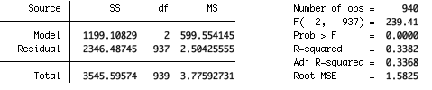
F-test
Critical value of F for df is 3.00
So we reject the null

Slide 20
F-test
Unlike in bivariate regression, F can be significant even if all of the individual T-tests are insignificant
This would be due to possible multicollinearity and joint effects

Slide 21
Interpretation
For alpha/intercept:
“When all X variables equal 0, the average/expected value of Y is…”
For beta/slope:
“On average, for each one unit increase in X_{i}, there will be a __ increase in Y, holding all other variables constant”
For a dummy variable:
“On average, [value 1] will be ___ units higher for Y than [value 0], holding all other variables constant”

Slide 22
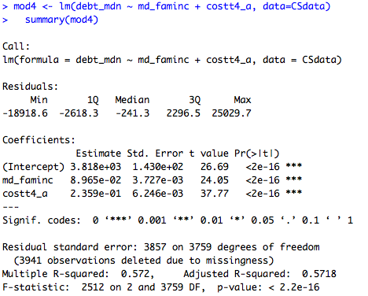
Example

Slide 23
Interpretation
“When all of the independent variables equal 0, the median debt among students at a college is predicted to be $3,818.”
“On average, for each additional dollar of median family income, students will have about $0.09 more median debt, holding all other variables constant.”
For each additional $1,000 dollars of median family income, students are predicted to have $89 more median debt, holding all other variables constant.

Slide 24
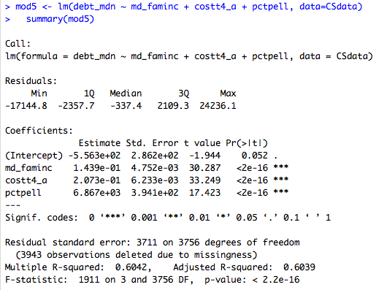
Example – Add % Pell

Slide 25
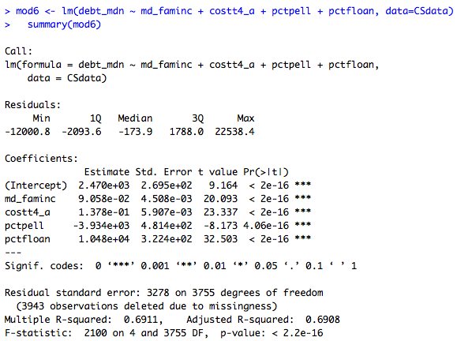
Example – Add % Federal Loans

Slide 26
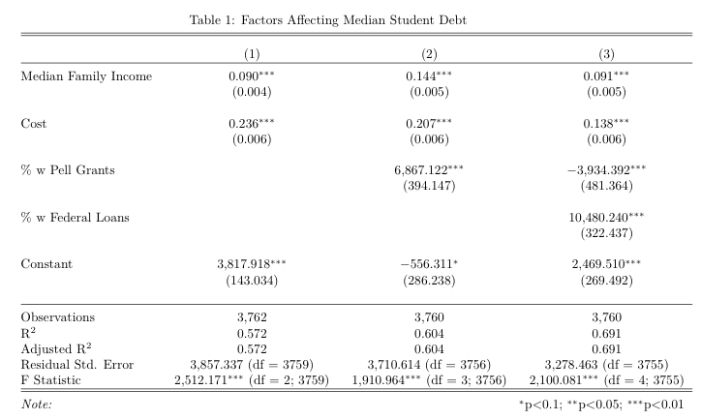
Stargazer Table

